Slide 1
Employee Data Analysis using Excel
STUDENT NAME: VISHNU PRIYA.V
REGISTER NO:312216152(asumn1621312216152)
DEPARTMENT: B.COM (A&F)
COLLEGE: SHRI SHANKARLAL SUNDARBAI SHASUN JAIN COLLEGE FOR WOMEN

Slide 2
PROJECT TITLE
Employee Performance Analysis using Excel

Slide 3


AGENDA
Problem Statement
Project Overview
End Users
Our Solution and Proposition
Dataset Description
Modelling Approach
Results and Discussion
Conclusion
3/21/2024 Annual Review

Slide 4

PROBLEM STATEMENT
EmployeesPerformance analysis is an essential aspect of managing any business and, if done correctly, can help management teams use data
analysis to their advantage to further business growth. Different crucial decisions like bonuses,
pay raises, promotions, etc. are taken based on
the performance evaluation of the employees in a
company or organization. These are some reasons to analyses th2e employee peerformances level.

Slide 5

PROJECT OVERVIEW
Analysing the performance level of employees considering various factors like gender, performance score, ratings, achievements and their contribution to the company. By this way we will be able to know how many employees are well-versed in their work and who needs improved, so that they can be motivated. This states the employees contribution level
.

Slide 6

WHO ARE THE END USERS?
The end users are the people in the hierarchy structure of the company like, manager, CEO, Managing director, Board members of that particular company

Slide 7

OUR SOLUTION AND ITS VALUE PROPOSITION
Conditional Formatting - To highlight the missing values Filter - To remove the missing values Formulas - To calculate employees performance level
from numeric to alphabetic
Pivot Table - To make the summary of the selected value
Slicer - Used to view one particular information from all
over the data.
Graph - To visualize the data in the most easier format

Slide 8
Dataset Description
* Employees - IBM EDUNET
* Available features - 26
* Considered features - 9
1. Emp ID - Numeric
2. First Name - Text
3. Last Name - Text
4. Employee Type
5. Gender - Male/Female
6. Performance score
7. Employee Rating -
Numeric
8. Business Unit
9. Employee Status

Slide 9

THE "WOW" IN OUR SOLUTION
I have created a new coloumn
named performance level to
update the employee ratings that
was in then numric form to text form using a formula ”,=IFS9(Z8>=5
,"VERY HIGH",Z8>=4,"HIGH",Z8>=3
,"MED",TRUE,"LOW")”. This shows
the numeric rating in the text
form with the name 1. very high
2. high
3. medium
4. low
3/21/2024 Annual Review

Slide 10
MODELLING
Data collection
1.Data set from Edunet Dashboard
Features collection
collected 26 features from dataset
only 9 features were taken into consideration
1. Emp ID - Numeric
2. First Name - Text
3. Last Name - Text
4. Employee Type
5. Gender - Male/Female
6. Performance score
7. Employee Rating - Numeric
8. Business Unit
9. Employee Status

Slide 11
Data cleaning
* Used conditional formatting to highlight the
blank coloumns. And,
* Filter option is used to remove the highlighted
coloumns
Performance level
* Identifed the employees performance level by
creating a new formula by using the coloumn
called employee rating
* The formula is - “=IFS(Z8>=5,"VERY HIGH",Z8>=4
,"HIGH",Z8>=3,"MED",TRUE,"LOW")”
Summary
* Summarized by use of Pivot tables
adding
1. business unit to the rows
2. performance level to the coloumn
3. gender to the filter
4. first name to the values

Slide 12
Data Vizualization
* done using
1. bar graph
trend lines are used to differentiate the
rating of the employee
2. pie chart
business units are used to differentiate
employee type
The results are shown below

Slide 13
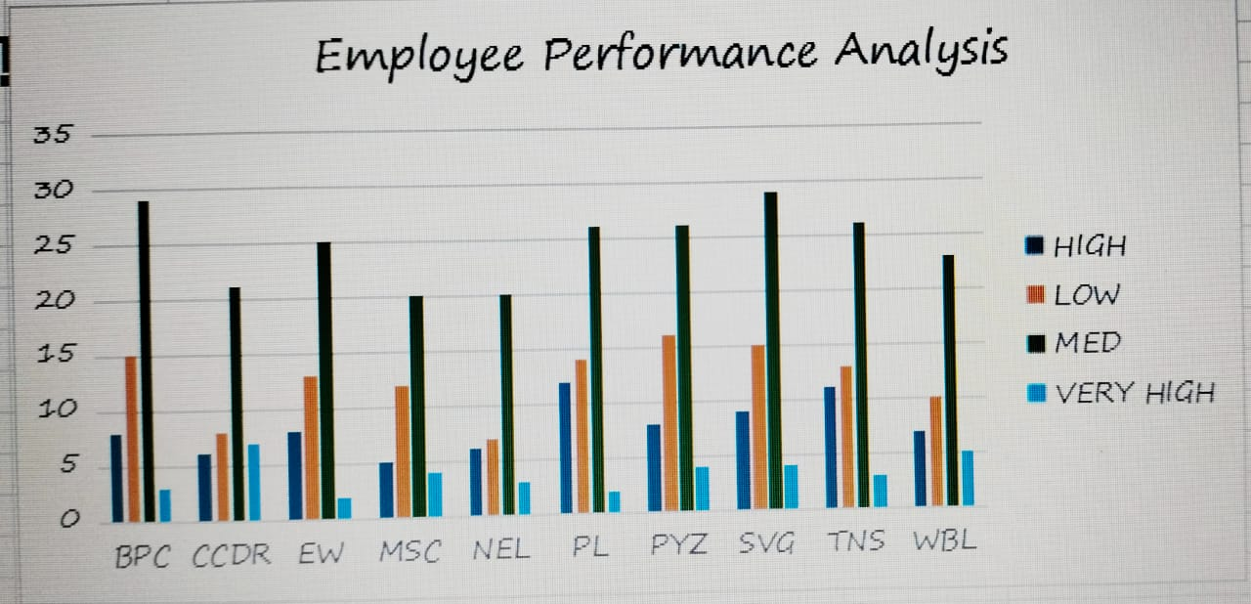
Result:

Slide 14
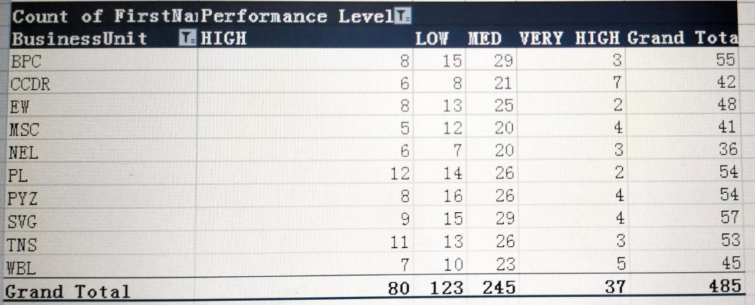
RESULTS

Slide 15
Conclusion:
And hence it is concluded that there MSC with full time higher than compared to other departments .

